Slide 1
A few remarks on meta-analyses
Witold Więcek
15 November 2021

Slide 2
History
Cochran (1953): averaging means via inverse-variance weighting
  Building up from Cochran and Fisher ideas dating back to 1930s
1970-1990: RCTs as basis of clinical decision-making and “evidence-based” medicine (Archie Cochrane)
Glass (1976): Primary, secondary, and meta-analysis of research
  First time term meta-analysis used
  Many estimation methods established throughout 1980s
Rubin (1981): Estimation in parallel experiments
  Bayesian hierarchical model
  Much rapid advance only from 1990s due to computational advances allowing for MCMC
Exponential growth in number of meta-analyses since 1990s
  Cochrane Collaboration (1993) and Campbell Collaboration (2000): systematic reviews in health and beyond
  Guidelines for meta-analyses also developed in 1990s
Notes:
Interesting to remember that this is all essentially happening within one generation and it’s a relatively recent development.
Bayesian methods historically less popular due to no viable computational solutions in 1990s.
Meta-analysis is a mature concept but there is still a lot of new work being done post 2010s: software implementations, comparisons of models, and---most important---assessment of usefulness of meta-analysis as a tool of EBM, also from institutional perspective.

Slide 3
Critiques
Researcher degrees of freedom in (1) choice of studies, (2) building models
Meta-analyses make it easy to ignore or underweight non-RCT evidence
“GIGO” issues
  Meta-analysis of low quality (small) studies can lead to overconfidence
  Risk of giving extra credibility to poor research
  Statistical power issues also apply to meta-analyses
Institutional critiques
  John Ioannidis, 2016: 3% of meta-analyses are “decent and clinically useful” (speculative)
  Richard Horton (editor in chief, the Lancet), 2019: “Imagine if the entire edifice of knowledge in medicine was built upon a falsehood.”
  Gøtzsche (BMJ EBM), 2019: “The Cochrane HPV vaccine review was incomplete and ignored important evidence of bias” (only 26out of 46 trials included, CoI)
Notes:
Ioannidis, John P.a. ‘The Mass Production of Redundant, Misleading, and Conflicted Systematic Reviews and Meta-Analyses’. The Milbank Quarterly 94, no. 3 (2016): 485–514. https://doi.org/10.1111/1468-0009.12210.
Horton, Richard. ‘Offline: The Gravy Train of Systematic Reviews’. The Lancet 394, no. 10211 (November 2019): 1790. https://doi.org/10.1016/S0140-6736(19)32766-7.
Roberts, Ian, and Katharine Ker. ‘How Systematic Reviews Cause Research Waste’. The Lancet 386, no. 10003 (17 October 2015): 1536. https://doi.org/10.1016/S0140-6736(15)00489-4.

Slide 4
Choice of studies (quick summary)
Preregistration (e.g. Cochrane Library)
PRISMA (checklist & flow diagram) prisma-statement.org
Assessing quality of studies, risk of bias
  Bias: selection, attrition, performance, detection, within-study reporting
Assessing (across-study) publication bias

Slide 5
Choice of outcome
Continuous: differences between means, but how to standardise?
  Choice not only of outcome but also of an estimator
Binary: risk difference, risk ratio, odds ratio
Other types of data and statistics can also be meta-analysed
Typically model summary statistics,
  If individual-level data available can also do a “2-stage” approach; can help in obtaining more precise estimators from different studies
  Fully joint model also possible: propagation of uncertainty

Slide 6
Role of graphical exploration
Not limited to forest plots
Bubble plots: should covariates be included?
L’Abbe plots: what (binary) outcome to use?
Model comparisons and robustness checks: plot differences between individual studies, mean effects, predicted effects
Plotting model vs data

Slide 7
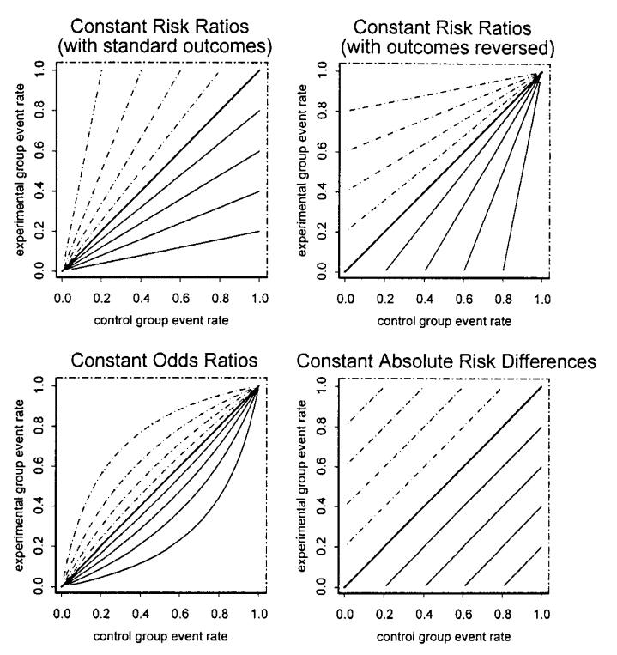
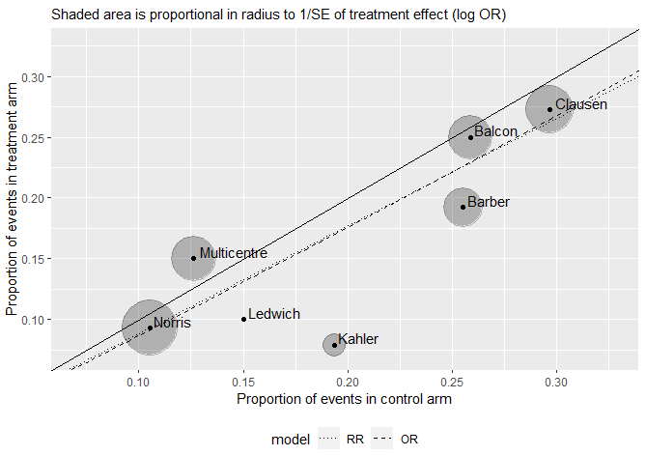
Graphical exploration: examples

Slide 8
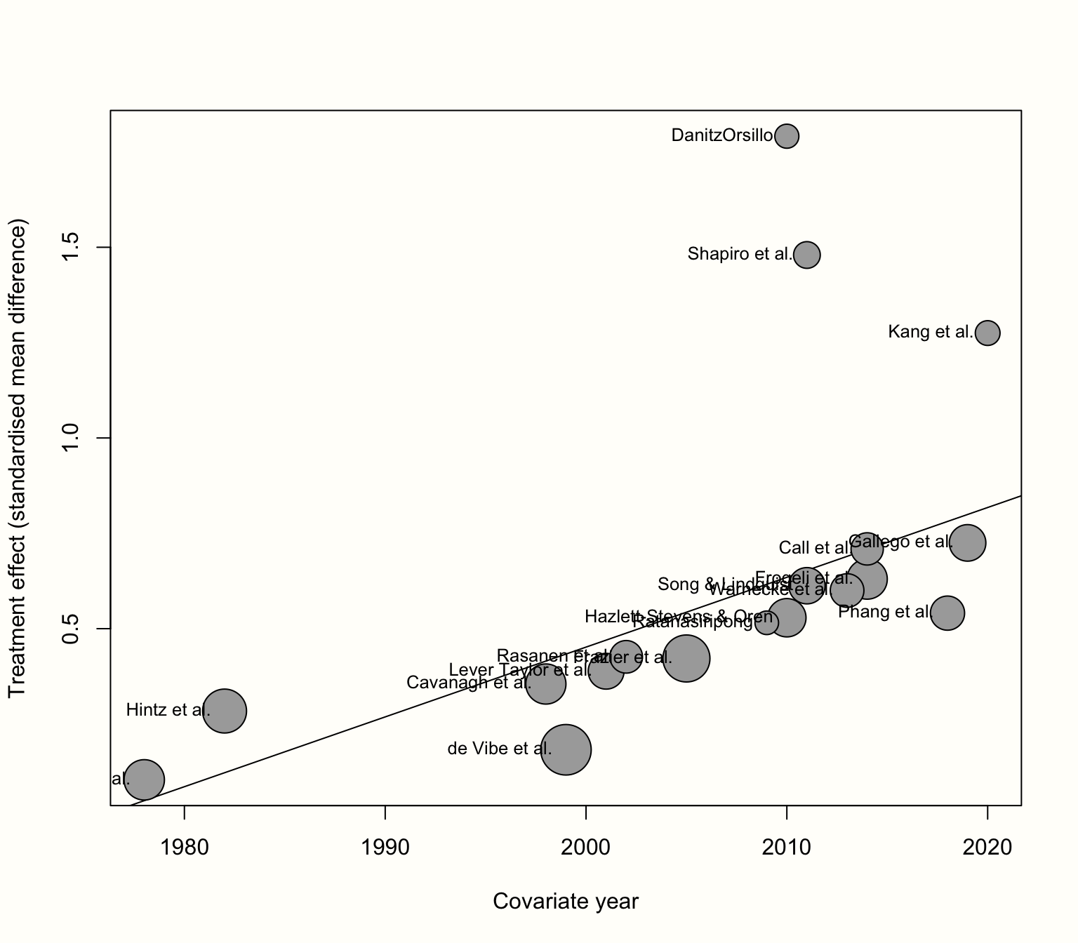
Graphical exploration: examples

Slide 9
Role of simulation
Robustness checks: resimulate studies and fit candidate models
Publication bias: add studies to the dataset
Power calculations
(For Bayesian models only) posterior predictive checking

Slide 10
Choice of model
(Typically) fixed vs random effects (partial vs full pooling) + inclusion of covariates
  FE vs RE terminology can be misleading and sometimes conflicting [1]
  Good to consider: (1) Data generating process, (2) Predictive checks (can the model replicate data?), (3) Graphical comparison, (4) Formal model comparison (LOOCV)
  …arguably easier in Bayesian models
Bayesian vs frequentist estimate?
[1] Andrew Gelman “Why I don’t use the term “fixed and random effects” | Statistical Modeling, Causal Inference, and Social Science (columbia.edu)

Slide 11
Method of inference
Bayesian methods more technically demanding than frequentist
Some cases where Bayesian models are especially useful:
  Regulating amount of pooling with priors, informative priors
  Imposing distribution of random effects (e.g. skewed)
  (Subjectively) easier to compare many models
  Using models as inputs into decision making (propagating uncertainty)
  Jointly modelling individual-level data
  Other models with complicated data generating processes

Slide 12
Making meta-analyses reproducible
In R:
  Frequentist: metafor, meta, netmeta
  Bayesian: baggr
Recent software advances make Bayesian inference for meta-analysis models as user-friendly as frequentist models
Meta-analyses should
  publish code (data management, model fitting, plots)
  include raw data
  show data in the publication (table and/or plots)

Slide 13
Other forms of meta-analysis
Non-exhaustive list of topics we haven’t covered:
Meta-regression / mixed models
Combining individual-level and summary data
Network meta-analysis (indirect evidence)
Impact on multiple parameters: mean & variance, quantiles, mixtures
Dealing with small samples
Model-based meta-analysis
  Parametric survival curves
Good to be familiar with at least a couple, even as illustrations of the topics we discussed.

Slide 14
Summary
Simulate data
Explore graphically
Compare many models

